Slide 1
PROBABILITY AND STATISTICS
SAMPLING DISTRIBUTION
MATH 30: PROBABILITY AND STATISTICS

Slide 2
Sampling Theory
Sampling theory is a study of relationships existing between a population and samples drawn from the population.
It is useful
in estimating unknown population parameters (such as mean, variance or proportion) from a knowledge of a certain sample quantities (sample statistics).
in determining whether the observed differences between two samples are due to chance variation or whether they are really significant. (Is a certain production process better than the other?)
MATH 30: PROBABILITY AND STATISTICS

Slide 3
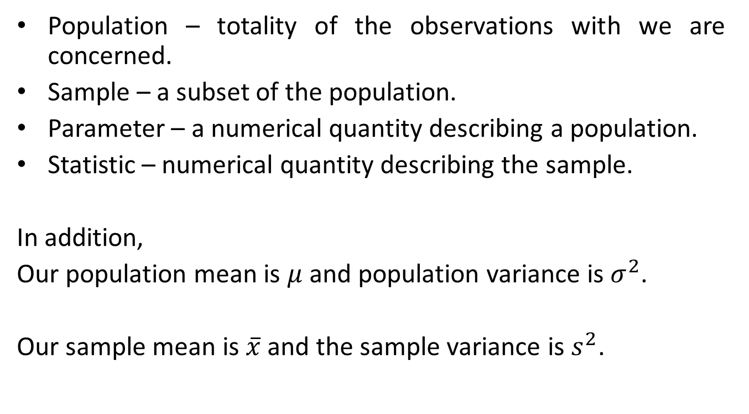
Recall:
Population – totality of the observations with we are concerned.
Sample – a subset of the population.
Parameter – a numerical quantity describing a population.
Statistic – numerical quantity describing the sample.
In addition,
Our population mean is $μ$ and population variance is $σ^{2}$.
Our sample mean is $\overline{x}$ and the sample variance is $s^{2}$.
MATH 30: PROBABILITY AND STATISTICS

Slide 4
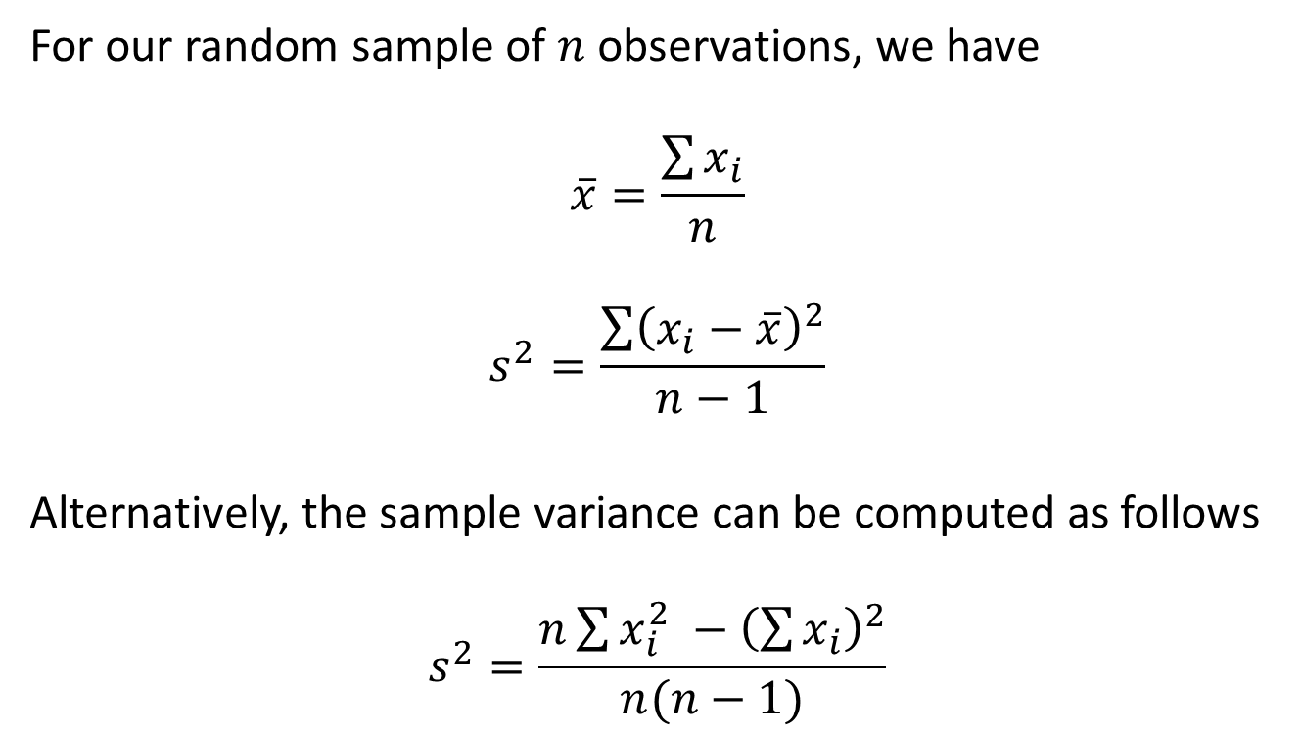
Recall:
For our random sample of $n$ observations, we have
$$\overline{x}=\frac{\sum{x_{i}}}{n}$$
$$s^{2}=\frac{\sum{{\left(x_{i}−\overline{x}\right)}^{2}}}{n−1}$$
Alternatively, the sample variance can be computed as follows
$$s^{2}=\frac{n\sum{x_{i}^{2} −{\left(\sum{x_{i}}\right)}^{2}}}{n(n−1)}$$
MATH 30: PROBABILITY AND STATISTICS

Slide 5
Illustration:
The grade-point averages of 20 college seniors selected at random from a graduating class are as follows:
3.2 1.9 2.1 2.4
2.8 2.9 3.8 3.0
2.5 3.3 1.8 2.5
3.7 2.8 2.0 3.2
2.3 2.1 2.5 1.9
Calculate the mean and standard deviation
MATH 30: PROBABILITY AND STATISTICS

Slide 6
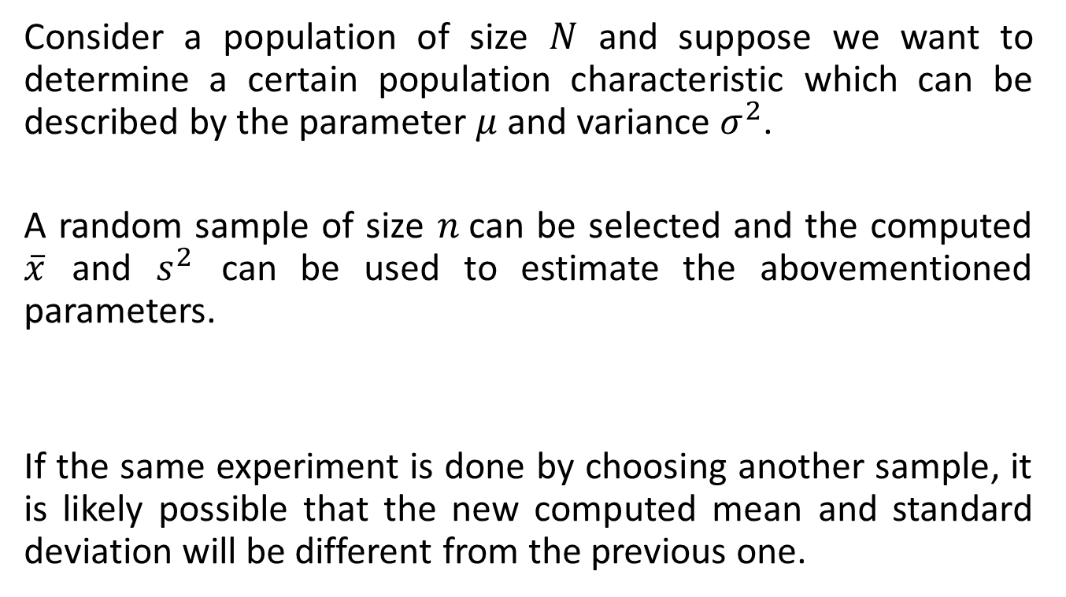
Sampling Distribution
Consider a population of size $N$ and suppose we want to determine a certain population characteristic which can be described by the parameter $μ$ and variance $σ^{2}$.
A random sample of size $n$can be selected and the computed $\overline{x}$ and $s^{2}$ can be used to estimate the abovementioned parameters.
If the same experiment is done by choosing another sample, it is likely possible that the new computed mean and standard deviation will be different from the previous one.
MATH 30: PROBABILITY AND STATISTICS

Slide 7
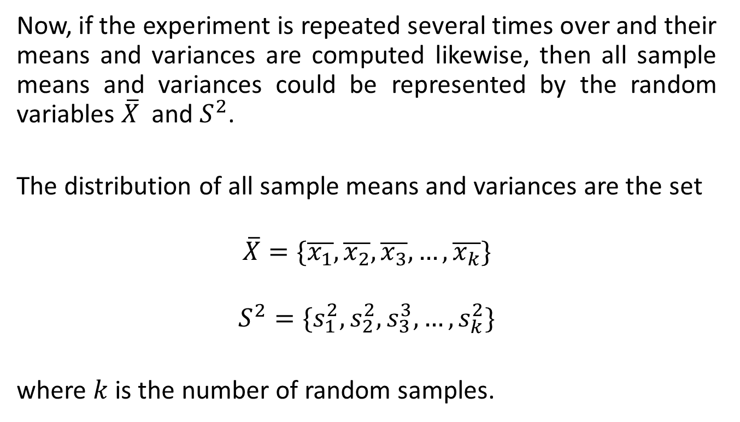
Sampling Distribution
Now, if the experiment is repeated several times over and their means and variances are computed likewise, then all sample means and variances could be represented by the random variables $\overline{X}$ and $S^{2}$.
The distribution of all sample means and variances are the set
$$\overline{X}=\{\overline{x_{1}},\overline{x_{2}},\overline{x_{3}},…,\overline{x_{k}}\}$$
$$S^{2}=\{s_{1}^{2},s_{2}^{2},s_{3}^{3},…, s_{k}^{2}\}$$
where $k$ is the number of random samples.
MATH 30: PROBABILITY AND STATISTICS

Slide 8
Sampling Distribution
Simply defined, the sampling distribution is the probability distribution of a certain statistic:
Some of the sampling distribution are as follows:
Sampling distribution of the mean
Sampling distributions of standard deviations
Sampling distribution of variances
Sampling distribution of proportion
Sampling distribution of the difference between two averages
MATH 30: PROBABILITY AND STATISTICS

Slide 9
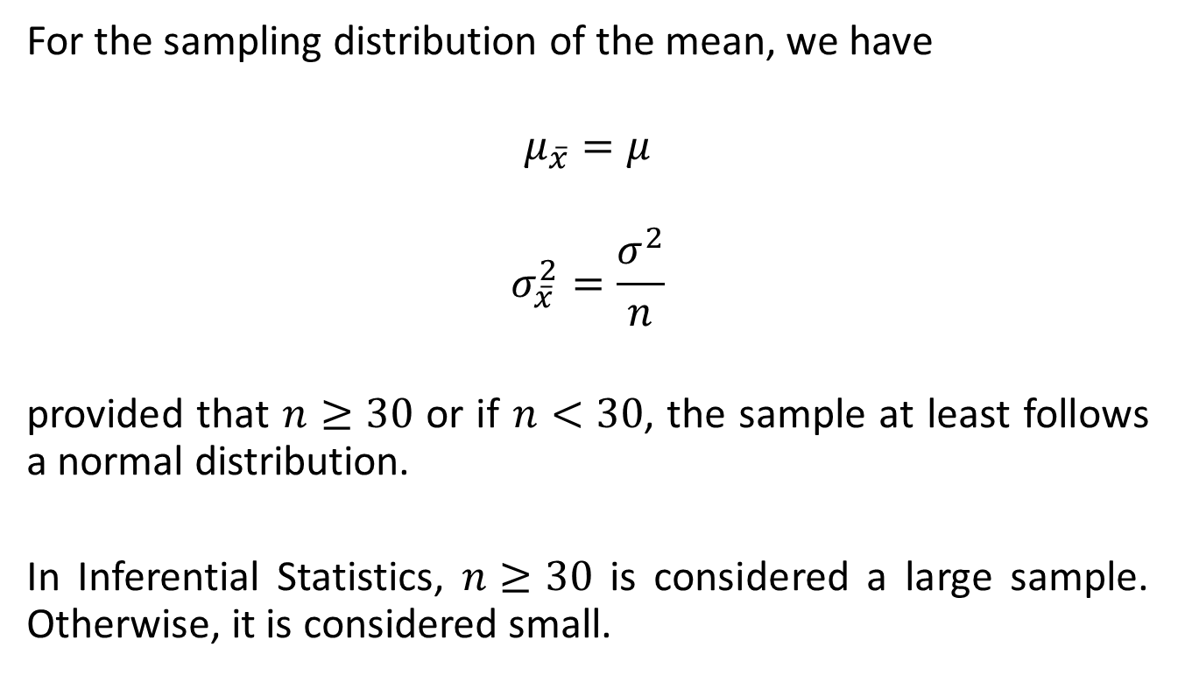
Sampling Distribution of the Mean
For the sampling distribution of the mean, we have
$$μ_{\overline{x}}=μ$$
$$σ_{\overline{x}}^{2}=\frac{σ^{2}}{n}$$
provided that $n≥30$ or if $n<30$, the sample at least follows a normal distribution.
In Inferential Statistics, $n≥30$ is considered a large sample. Otherwise, it is considered small.
MATH 30: PROBABILITY AND STATISTICS

Slide 10
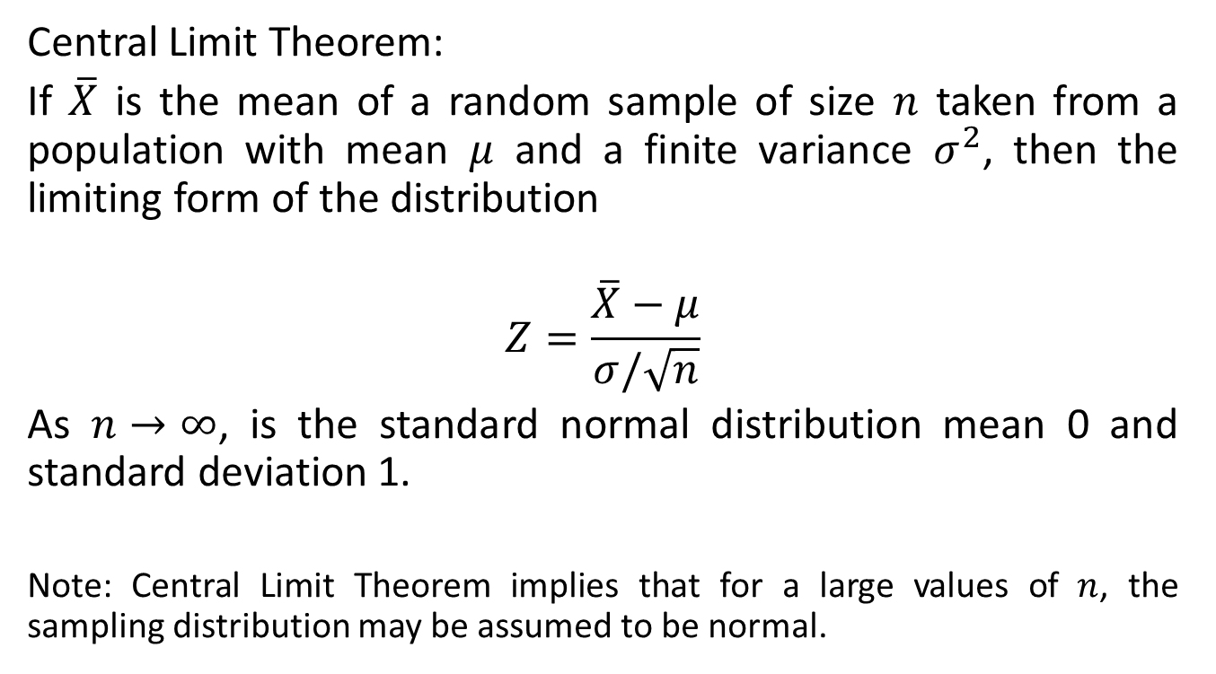
Sampling Distribution of the Mean
Central Limit Theorem:
If $\overline{X}$ is the mean of a random sample of size $n$ taken from a population with mean $μ$ and a finite variance $σ^{2}$, then the limiting form of the distribution
$$Z=\frac{\overline{X}−μ}{σ/\sqrt{n}}$$
As $n→∞$, is the standard normal distribution mean 0 and standard deviation 1.
Note: Central Limit Theorem implies that for a large values of $n$, the sampling distribution may be assumed to be normal.
MATH 30: PROBABILITY AND STATISTICS

Slide 11
Sampling Distribution of the Mean
ILLUSTRATION:
An electrical firm manufactures light bulbs that have a length of life that is approximately normally distributed, with mean equal to 80O hours and a standard deviation of 40 hours. Find the probability that a random sample of 16 bulbs will have an average life of less than 775 hours.
The average life of a bread-making machine is 7 years, with a standard deviation of 1 year. Assuming that the lives of these machines follow approximately a normal distribution, find the probability that the mean life of a random sample of 9 such machines falls between 6.4 and 7.2 years.
MATH 30: PROBABILITY AND STATISTICS

Slide 12
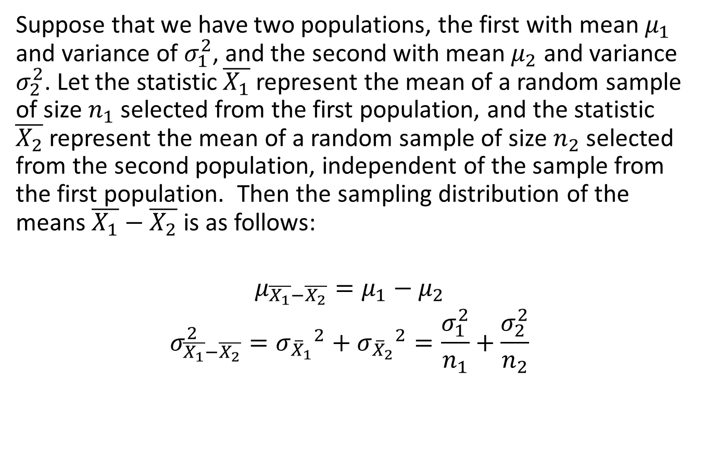
Sampling Distribution of the Difference between two Averages
Suppose that we have two populations, the first with mean $μ_{1}$ and variance of $σ_{1}^{2}$, and the second with mean $μ_{2}$ and variance $σ_{2}^{2}$. Let the statistic $\overline{X_{1}}$ represent the mean of a random sample of size $n_{1}$ selected from the first population, and the statistic $\overline{X_{2}}$ represent the mean of a random sample of size $n_{2}$ selected from the second population, independent of the sample from the first population. Then the sampling distribution of the means $\overline{X_{1}}−\overline{X_{2}}$ is as follows:
$$μ_{\overline{X_{1}}−\overline{X_{2}}}=μ_{1}−μ_{2}$$
$$σ_{\overline{X_{1}}−\overline{X_{2}}}^{2}={σ_{{\overline{X}}_{1}}}^{2}+{σ_{{\overline{X}}_{2}}}^{2}=\frac{σ_{1}^{2}}{n_{1}}+\frac{σ_{2}^{2}}{n_{2}}$$
MATH 30: PROBABILITY AND STATISTICS

Slide 13
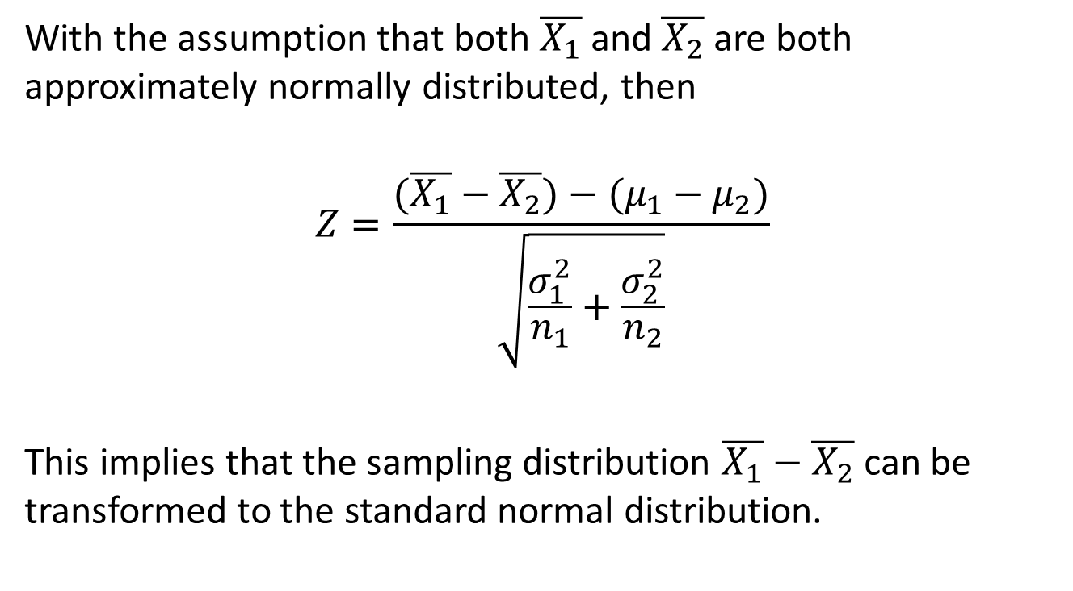
Sampling Distribution of the Difference between two Averages
With the assumption that both $\overline{X_{1}}$ and $\overline{X_{2}}$ are both approximately normally distributed, then
$$Z=\frac{(\overline{X_{1}}−\overline{X_{2}})−(μ_{1}−μ_{2})}{\sqrt{\frac{σ_{1}^{2}}{n_{1}}+\frac{σ_{2}^{2}}{n_{2}}}}$$
This implies that the sampling distribution $\overline{X_{1}}−\overline{X_{2}}$ can be transformed to the standard normal distribution.
MATH 30: PROBABILITY AND STATISTICS

Slide 14
Sampling Distribution of the Difference between two Averages
ILLUSTRATIONS:
The television picture tubes of manufacturer A have a mean lifetime of 6.5 years and a standard deviation of 0.9 year, while those of manufacturer B have a mean lifetime of 6.0 years and a standard deviation of 0.8 year. What is the probability that a random sample of 36 tubes from manufacturer A will have a mean lifetime that is at least 1 year more than the mean lifetime of a sample of 49 tubes from manufacturer B?
The distribution of heights of a certain breed of terrier dogs has a mean height of 72 centimeters and a standard deviation of 10 centimeters, whereas the distribution of heights of a certain breed of poodles has a mean height of 28 centimeters with a standard deviation of 5 centimeters. Assuming that the sample means can be measured to any degree of accuracy, find the probability that the sample mean for a random sample of heights of 64 terriers exceeds the sample mean for a random sample of heights of 100 poodles by at most 44.2 centimeters.
MATH 30: PROBABILITY AND STATISTICS

Slide 15
EXERCISES:
If a certain machine makes electrical resistors having a mean resistance of 40 ohms and a standard deviation of 2 ohms, what is the probability that a random sample of 36 resistors will have a combined resistance of more than 1458 ohms?
A random sample of size 25 is taken from a normal population having a mean of 80 and a standard deviation of 5. A second random sample of size 36 is taken from a different normal population having a mean of 75 and a standard deviation of 3. Find the probability that the sample mean computed from the 25 measurements will exceed the sample mean computed ftom the 36 measurements by at least 3.4 but less than 5.9 (Assume the means to be measured to the nearest tenth.)
MATH 30: PROBABILITY AND STATISTICS

